Slide 1

SENTIMENT ANALYSIS USING MACHINE LEARNING AND DEEP LEARNING
PRESENTED BY
NOOTHI KRISHNA ROHIT – L20564458
SAMAVEDAM VENKATA SATYA SURYA SUBRAMANYAM – L20573476
SERVEPALLI DEEPIKA MEGHASENA – L20555071

Slide 2

AGENDA
INTRODUCTION
SIGNIFICANCE
OBJECTIVE
ARCHITECTURE AND METHODOLOGY
MODULES
IMPLEMENTATION
Data flow DIAGRAM
references

Slide 3

Sentiment Analysis of Twitter Data introduction

Slide 4
INTRODUCTION
Social media platforms like Twitter are vital sources of information and opinions globally.
Twitter allows users to express thoughts, emotions, and opinions through short text messages called tweets.
Sentiment analysis of Twitter data offers insights into public opinion, customer feedback, and emerging trends.

Slide 5
SIGNIFICANCE
Brands & Businesses: Gauge customer satisfaction, identify product issues, and assess marketing campaigns.
Politics & Elections: Predict public opinion, track candidate popularity, and understand voter sentiment.
Finance: Monitor market reactions, detect trends, and make informed decisions.
Social Listening: Monitor brand reputation, respond to feedback, and engage with audiences.
Disaster & Crisis Management: Assess public response during emergencies and crises.

Slide 6
OBJECTIVES
Collecting a dataset of tweets related to a specific topic, brand, or event.
Preprocessing tweet data to remove noise, perform text normalization, and handle special characters/emoticons.
Applying sentiment analysis techniques and machine learning algorithms for sentiment classification.
Evaluating model performance using appropriate metrics.

Slide 7
ARCHITECTURE AND METHODOLOGY

Slide 8
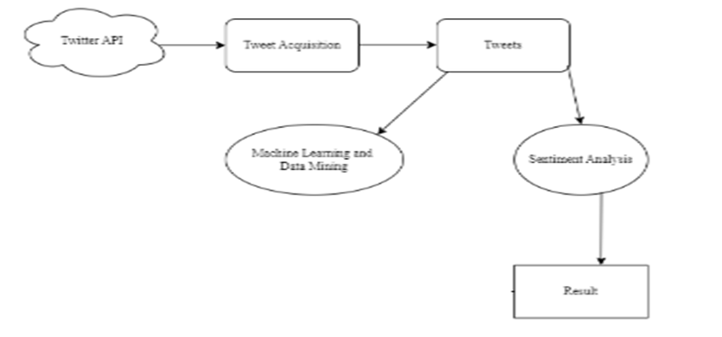
ARCHITECTURE
DATA ACQUISITION
PREPROCESSING
ANALYSIS
RESULT GENERATION

Slide 9
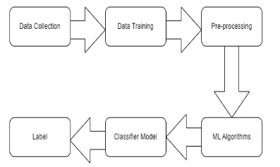
Data Collection: Acquiring relevant Twitter datasets for analysis.
Data Preprocessing: Cleaning and preparing the data for further processing.
Techniques: Stemming, Tokenization, etc. Feature Decision Tree, Logistic Regression, Support Vector Classifier and Random Forest Classifier algorithms are used here.
Extraction: Identifying key features from tweets relevant to sentiment.
BagofWords (BOW) model for word frequency analysis.
METHODOLOGY

Slide 10
MODULES
Data PreProcessing
Purpose: Clean raw tweet data for better analysis.
Method: User defined function using NLTK library.
Stemming: Reduce words to their root form.
Tokenization: Split sentences into individual words.

Slide 11
Word Popularity Analysis
Objective: Identify frequently occurring words and ngrams.
Process: Count word occurrences within the corpus. Present top 50 popular words with their frequency.
Calculate word repetition probability based on total corpus size.
Word Popularity Detection using Ngrams
Concept: Analyze word sequences (ngrams) for popularity.
Method: Developed ngram model to analyze tokenized words. Identify popular single words and word combinations.

Slide 12
Sentiment Analysis
Goal: Measure public opinion trends.
Method: NLTKbased Sentiment Analyzer to analyze sentiment.
Calculate sentiment scores for positive, negative, and neutral classes.
Derive a compound sentiment score for each tweet.
Sentiment Classification
Process: Classify tweets based on compound sentiment scores.
Assign sentiment polarity rating (positive, negative, neutral) to each tweet.

Slide 13
IMPLEMENTATION
MODULES
System Construction
Tweets, Retweets and Retweeters
Lexicon-Based Sentiment Analysis
Quantitative Study

Slide 14
System Construction Module
Function: Build a system for analyzing Covid related sentiment on Twitter.
Components:
User Interface: Allows users to search for Covid tweets, specific users, and hashtags.
Data Mining: Extracts relevant information from Twitter data about Covid tweets.
Visualization: Presents retrieved data in a user friendly format (e.g., tables, charts).
Tweets, Retweets and Retweeters
Integrated Approach: Our method combines temporal tweet patterns and network dynamics to infer Covid leaning on Twitter, ensuring consistency in content and audience similarity.
Optimization Framework: We employ a robust convex optimization framework to maximize tweet-retweet agreement and user similarity, providing precise inferences despite data heterogeneity.
Interpretable Scores: Our computed scores reflect user sentiment simply as the average number of positive or negative tweets when retweeting a user, facilitating easy interpretation for informed decision-making.

Slide 15
Lexicon Based Sentiment Analysis
Method: Utilize SentiStrength, a lexicon based tool, to classify tweet sentiment (positive, negative, neutral).
Customization: Adapt the sentiment lexicon by incorporating high frequency Covid related words and removing irrelevant terms.
Quantitative Study
Objective: Analyze Covid leaning trends and user demographics.
Data:1,000 most frequently retweeted users.232,000 users who retweeted these sources at least 10 times.
Findings: Parody accounts tend to be more liberal and less temporally stable.
Less vocal users lean more liberal, while highly vocal users have a balanced liberal conservative split.
Hashtag usage patterns shift significantly during Covid events. Active user participation during events increases the overall liberal leaning and reduces polarization..

Slide 16
ALGORITHMS

Slide 17
Decision Tree Classifier: Provided a clear indication of feature importance and decision making process.
Logistic Regression: A baseline model for binary classification tasks.
Random Forest Classifier: An ensemble method that improves prediction accuracy by reducing overfitting.
Naive Bayes (BernoulliNB): Effective for large datasets with binary or boolean features.
KNearest Neighbors (KNN): A nonparametric method used for classification and regression

Slide 18
Decision Tree
Decision Trees are a type of Supervised Machine Learning where the data is continuously split according to a certain parameter.
The tree can be explained by two entities, namely decision nodes and leaves.
The leaves are the decisions or the final outcomes. And the decision nodes are where the data is split.

Slide 19
Logistic Regression
Logistic regression is a statistical model that in its basic form uses a logistic function to model a binary dependent variable, although many more complex extensions exist.
In regression analysis, logistic regression (or logit regression) is estimating the parameters of a logistic model (a form of binary regression).

Slide 20
Support Vector Machine (SVC)
Support Vector Machine (SVM) is a supervised machine learning algorithm which can be used for both classification or regression challenges.
However, it is mostly used in classification problems. In the SVM algorithm, we plot each data item as a point in n-dimensional space (where n is the number of features you have) with the value of each feature being the value of a particular coordinate.

Slide 21
Random Forest: Random forests or random decision forests are an ensemble learning method for classification, regression and other tasks that operate by constructing a multitude of decision trees at training time and outputting the class that is the mode of the classes (classification) or mean prediction (regression) of the individual trees.
Naive Bayes: Naive Bayes classifiers are a family of simple "probabilistic classifiers" based on applying Bayes' theorem with strong (naive) independence assumptions between the features. They are among the simplest Bayesian network models.

Slide 22
K-Nearest Neighbors (KNN)
K-Nearest Neighbors is one of the most basic yet essential classification algorithms in Machine Learning.
It belongs to the supervised learning domain and finds intense application in pattern recognition, data mining and intrusion detection.

Slide 23
DATA FLOW DIAGRAM

Slide 24
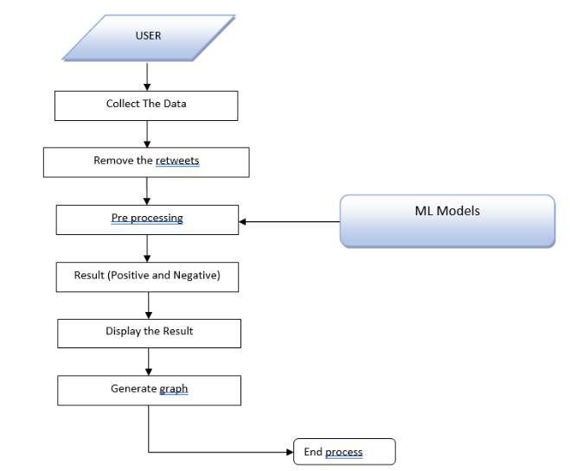
DATA FLOW DIAGRAM
Gather tweets from the specified user
Exclude retweets
Preprocess the tweet data
Categorize the tweets into positive and negative
Display the results

Slide 25
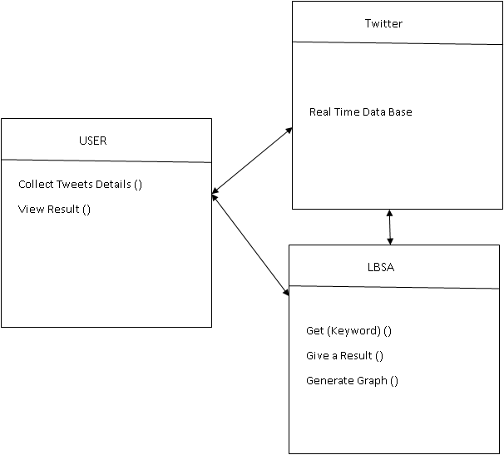
Class Diagram

Slide 26
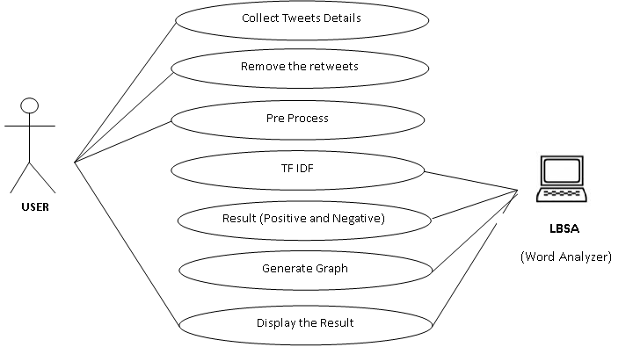
Use Case

Slide 27
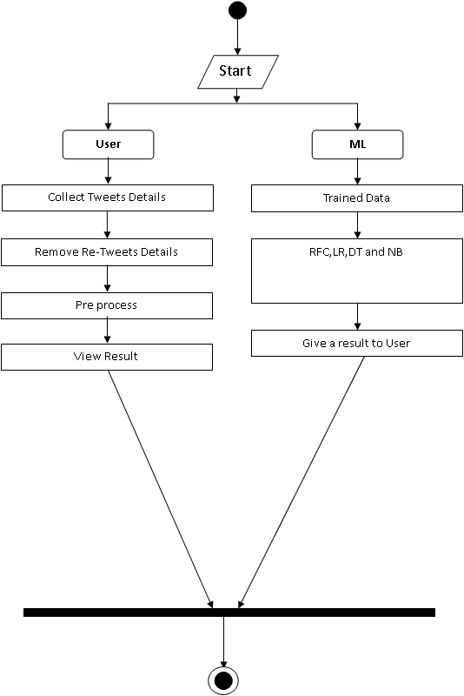
Activity

Slide 28
OUTPUT

Slide 29
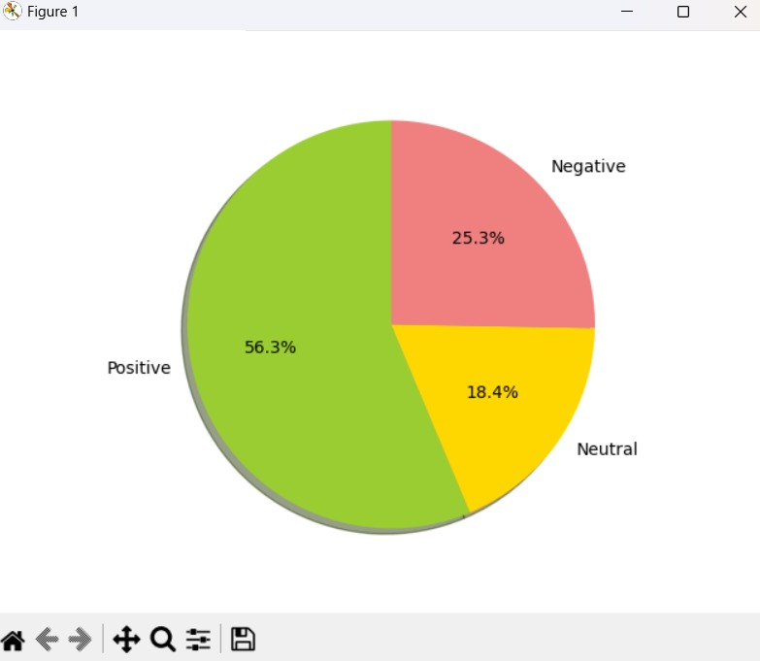
ANALYSIS

Slide 30
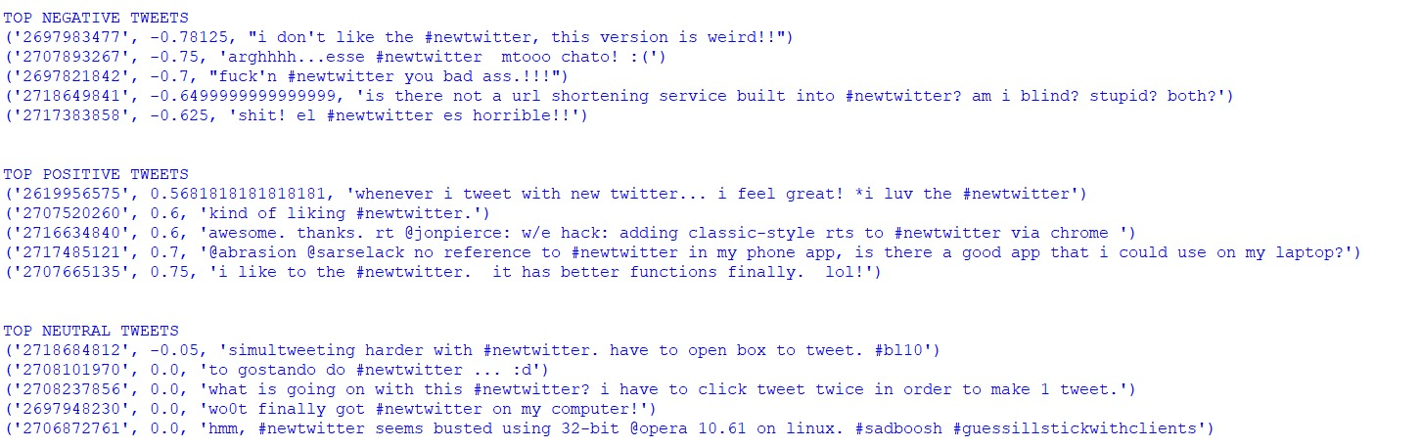
RESULT VIEW OF TOP 5 TWEETS

Slide 31
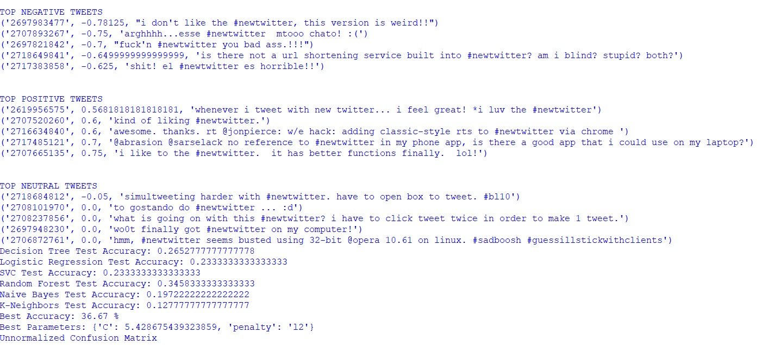
RESULT VIEW OF ALGORITHMS

Slide 32
REFERENCES
[1] N. F. F. da Silva, E. R. Hruschka, and E. R. Hruschka, ‘‘Tweet senti ment analysis with classifier ensembles,’’ Decis. Support Syst., vol. 66, pp. 170–179, Oct. 2014.
[2] C. Kariya and P. Khodke, ‘‘Twitter sentiment analysis,’’ in Proc. Int. Conf. Emerg. Technol. (INCET), Jun. 2020, pp. 212–216.
[3] A. Alsaeedi and M. Zubair, ‘‘A study on sentiment analysis techniques of Twitter data,’’ Int. J. Adv. Comput. Sci. Appl., vol. 10, no. 2, pp. 361–374, 2019.
[4] A. Bandhakavi, N. Wiratunga, D. Padmanabhan, and S. Massie, ‘‘Lexicon based feature extraction for emotion text classification,’’ Pattern Recognit. Lett., vol. 93, pp. 133–142, Jul. 2017.J. Clerk Maxwell, A Treatise on Electricity and Magnetism, 3rd ed., vol. 2. Oxford: Clarendon, 1892, pp.6873.
[5] J. Capdevila, J. Cerquides, J. Nin, and J. Torres, ‘‘TweetSCAN: An event discovery technique for geolocated tweets,’’ Pattern Recognit. Lett., vol. 93, pp. 58–68, Jul. 2017.
[6] T. Alsinet, J. Argelich, R. Béjar, C. Fernández, C. Mateu, and J. Planes, ‘‘An argumentative approach for discovering relevant opinions in Twitter with probabilistic valued relationships,’’ Pattern Recognit. Lett., vol. 105, pp. 191–199, Apr. 2018.
[7] W. Chen, Y. Zhang, C. K. Yeo, C. T. Lau, and B. S. Lee, ‘‘Unsupervised rumor detection based on users’ behaviors using neural networks,’’ Pattern Recognit. Lett., vol. 105, pp. 226–233, Apr. 2018.
[8] H. Hakh, I. Aljarah, and B. AlShboul, ‘‘Online social mediabased sentiment analysis for us airline companies,’’ in New Trends in Information Technology. Amman, Jordan: Univ. of Jordan, Apr. 2017.

Slide 33

THANK YOU

